Slide 1
Unified Modelling Language(UML)
What is UML?
Goals of UML?
Why use UML?
Sehrish Aqeel
www.aisciences.io

Slide 2
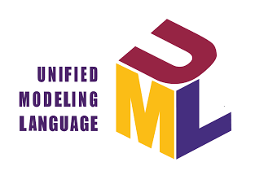
Unified Modelling Language (UML)
UML, short for Unified Modeling Language, is a standardized modeling language consisting of an integrated set of diagrams, developed to help system and software developers for specifying, visualizing, constructing, and documenting the artifacts of software systems, as well as for business modeling and other non-software systems.

Slide 3
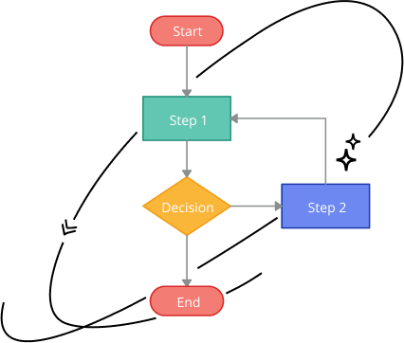
Why we use UML?
Permits you to specify the structure or behavior of a system.
Helps you visualize a system.
Provides template that guides you in constructing a system.
Helps to understand complex system part by part.
Document the decisions that you have made.

Slide 4
Goals of UML
I) Provide users with a ready-to-use, expressive visual modeling language so they can develop and exchange meaningful models.
2) Provide extensibility and specialization mechanisms to extend the core concepts.
3) Be independent of particular programming languages and development processes.
4) Provide a formal basis for understanding the modeling language.
5) Support higher-level development concepts such as collaborations, frameworks, patterns, and components.
6) Integrate best practices.

